Slide 1
Feds vs. anti-feds

Slide 2
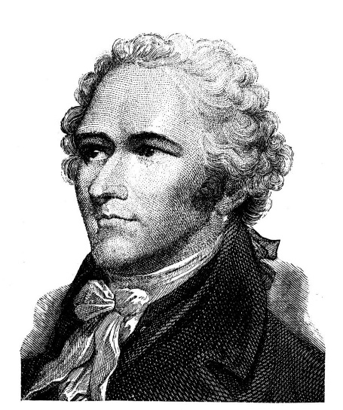
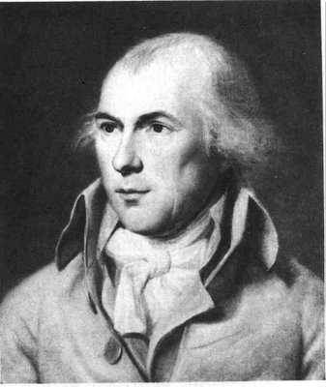
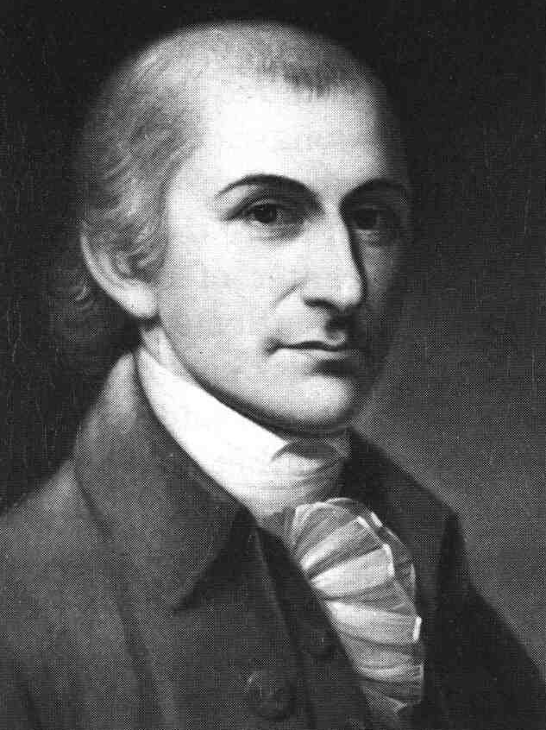
What is a federalist?
A federalist is anyone who supports ratifying the Constitution
Alexander Hamilton James Madison John Jay

Slide 3
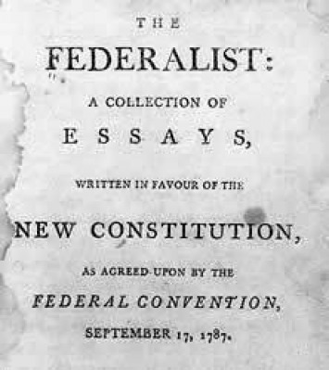
Federalist Papers
Were documents written to analyze the Constitution
Most newspapers supported the Constitution
Loved the Constitution just the way it was!
Why do you think Madison was a federalist?
Nickname??
Federalist papers *Publius (alias)
85 essays

Slide 4
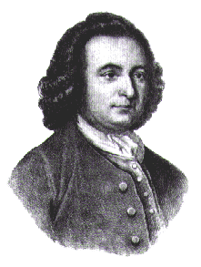
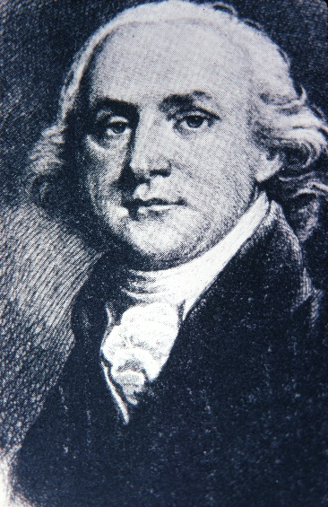
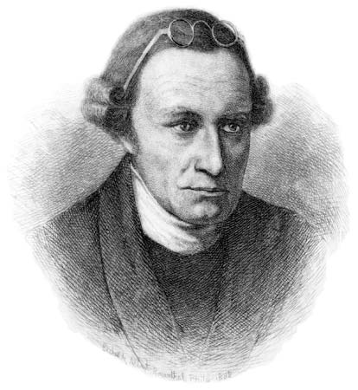
What is an Anti-Federalist?
An anti-federalist is anyone that opposed the Constitution as it was currently written
George Mason Patrick Henry Robert Yates

Slide 5
Anti-federalist Papers
Were documents written to attack the defective Constitution
Published their views in pamphlets and newspapers
Used reason (logic) and emotion to influence readers
Anti-Feds *Brutus

Slide 6
FEDERALISTS POWER IN NATIONAL GVT | ANTI-FEDERALISTS POWER IN STATE GVT
Believe in common good over individual rights | Individual rights are most important (BOR)
Supported taking powers from states to give it to the national government | Wanted the majority of power to stay with the states
Favored dividing power among three branches | Wanted legislative branch to have more power than the executive branch Strong executive branch = king/tyrant
Proposed single person leads executive branch | Bill of Rights must be listed in the Constitution to protect the people

